Slide 1
A Generalist Agent(GATO)
Deepmind 2022.5

Slide 2
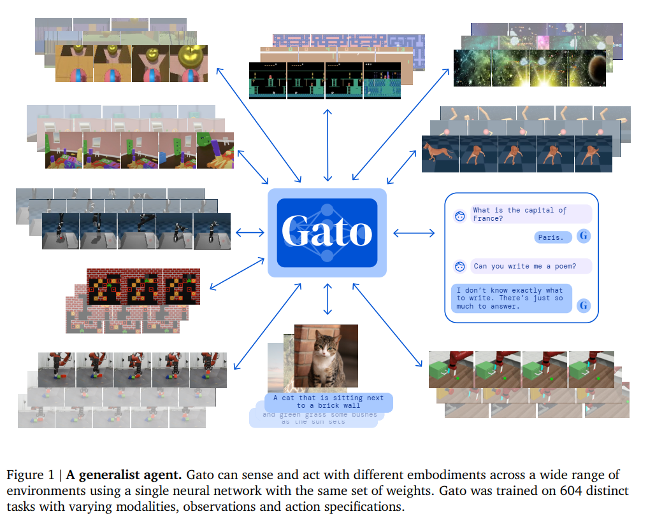
Definition
“Gato works as a multi-task generalist policy, The same network with the same weights can play games, chat, caption image and so on deciding on its context.”

Slide 3
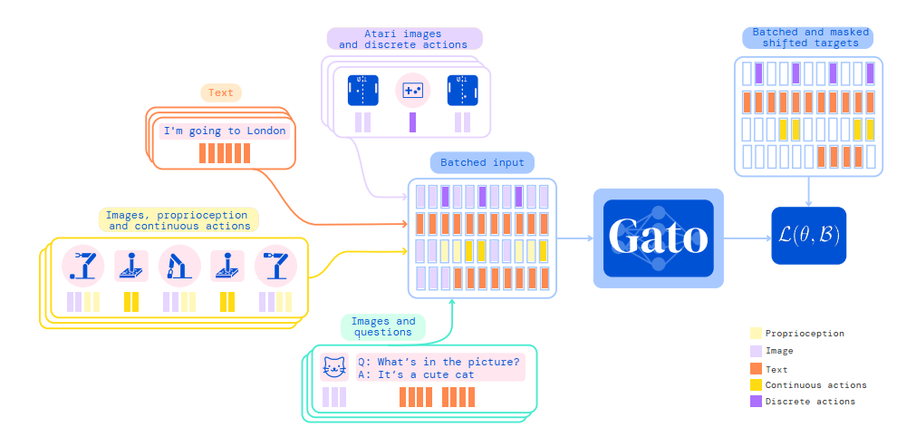
Principle
“To enable processing this multi-modal data, we serialize all data into a flat sequence of tokens. ”

Slide 4
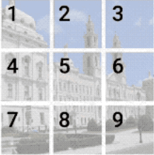
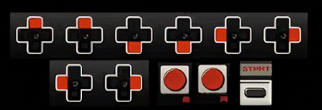
Tokenize
Text: SentencePiece, table with 32000 subwords into the integer range [0, 32000).
Image: ViT, transformed into 16x16 patches in raster order. Each pixel in the image patches is then normalized between [−1, 1] and divided by the square-root of the patch size.
Discrete values: flattened into sequences of integers. The tokenized result is a sequence of integers within the range of [0, 1024)
Continuous values: First flattened into sequences of floating point values, then discretized and shifted to the range of [32000, 33024).

Slide 5
Embedding
“Tokens belonging to text, discrete- or continuous-valued observations or actions for any timestep are embedded via a lookup table into a learned vector embedding space.”
“Tokens belonging to image patches for any time-step are embedded using a single ResNet (He et al., 2016a) block to obtain a vector per patch.”
“Gato’s network architecture has two main components: the parameterized embedding function which transforms tokens to token embeddings, and the sequence model which outputs a distribution over the next discrete token.”

Slide 6
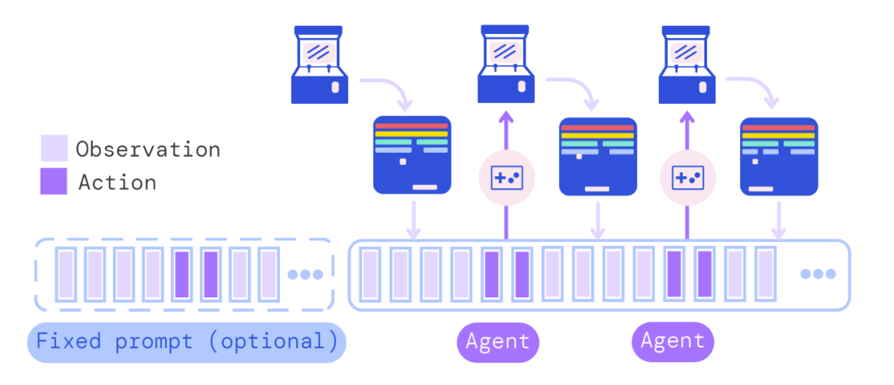
Trick: Prompt conditioning
For 25% of the sequences, a prompt sequence is prepended. Half of them are from the end of the episode. The other half are uniformly sampled.

Slide 7


Training: loss function

Slide 8
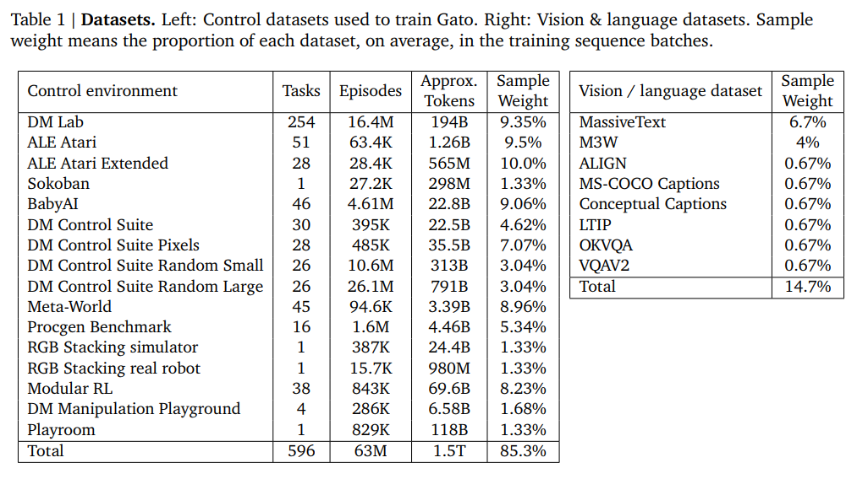
Datasets

Slide 9
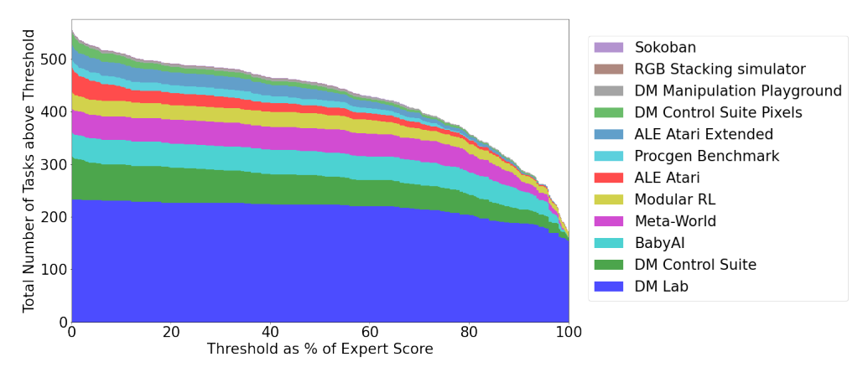
Performance
Gato performs over 450 out of 604 tasks at over a 50% expert score threshold.

Slide 10
In ALE Atari, Gato achieves the average human (or better) scores for 23 Atari , achieving over twice human score for 11 games.
On BabyAI, Gato achieves over 80% of expert score for nearly all tasks.
On Meta-World, Gato achieves more than 50% for all 44 out of 45 tasks that we trained on, over 80% for 35 tasks, and over 90% for 3 tasks.
On DM Control, Gato achieves better than 50% of the expert score on 21 out of 30 tasks from state, and more than 80% for 18 tasks.

Slide 11
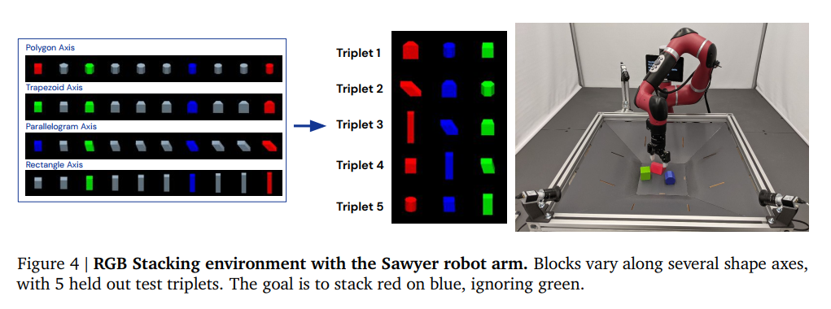
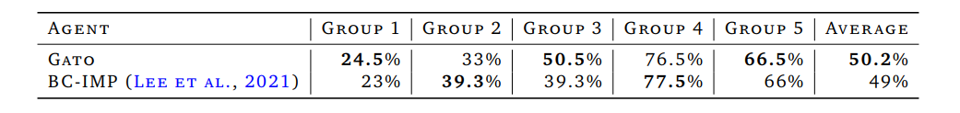

Slide 12
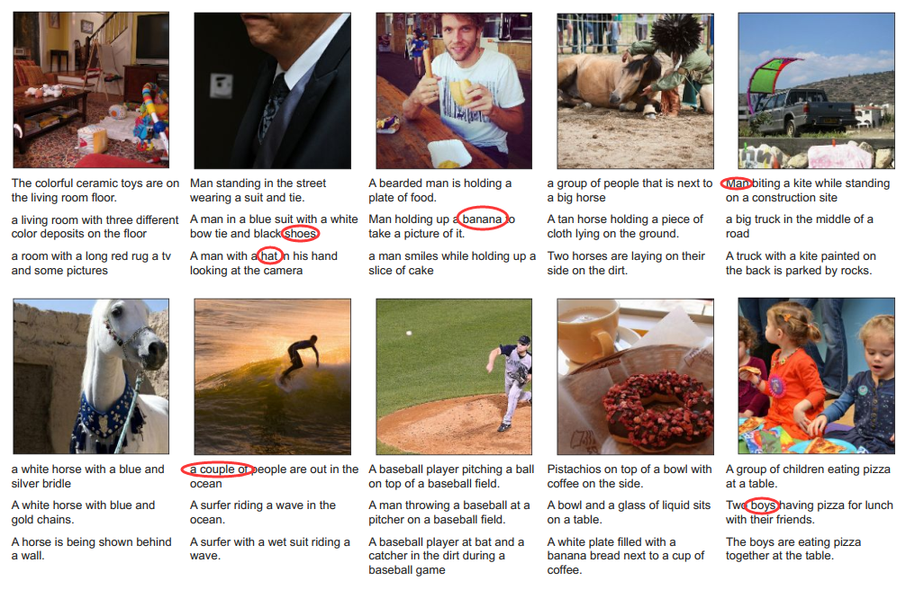

Slide 13
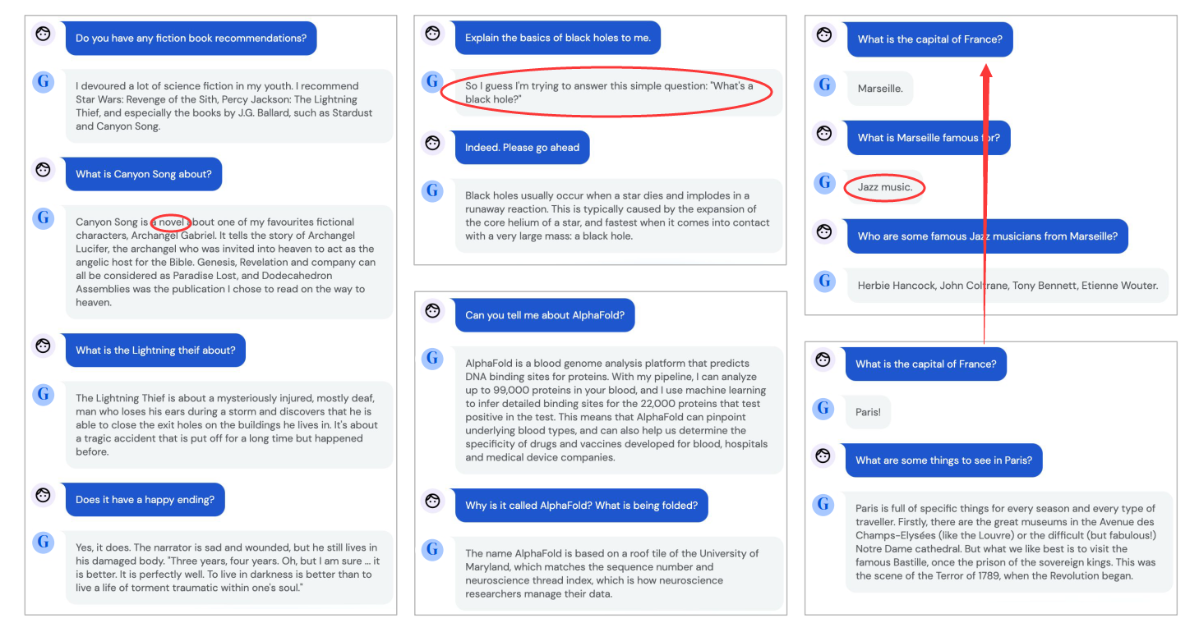

Slide 14
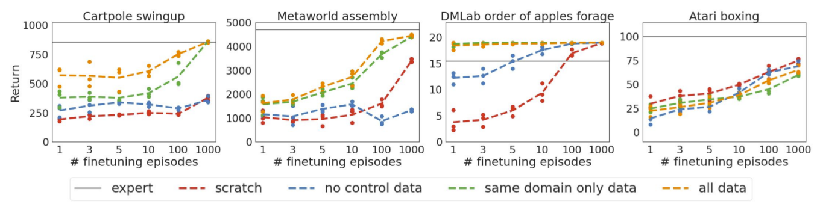
Finetune
“Agents in the DM Lab environment are fed images which, despite being simulated, are natural looking.”
The Atari boxing game’s input images being visually very distinct from the other data.

Slide 15
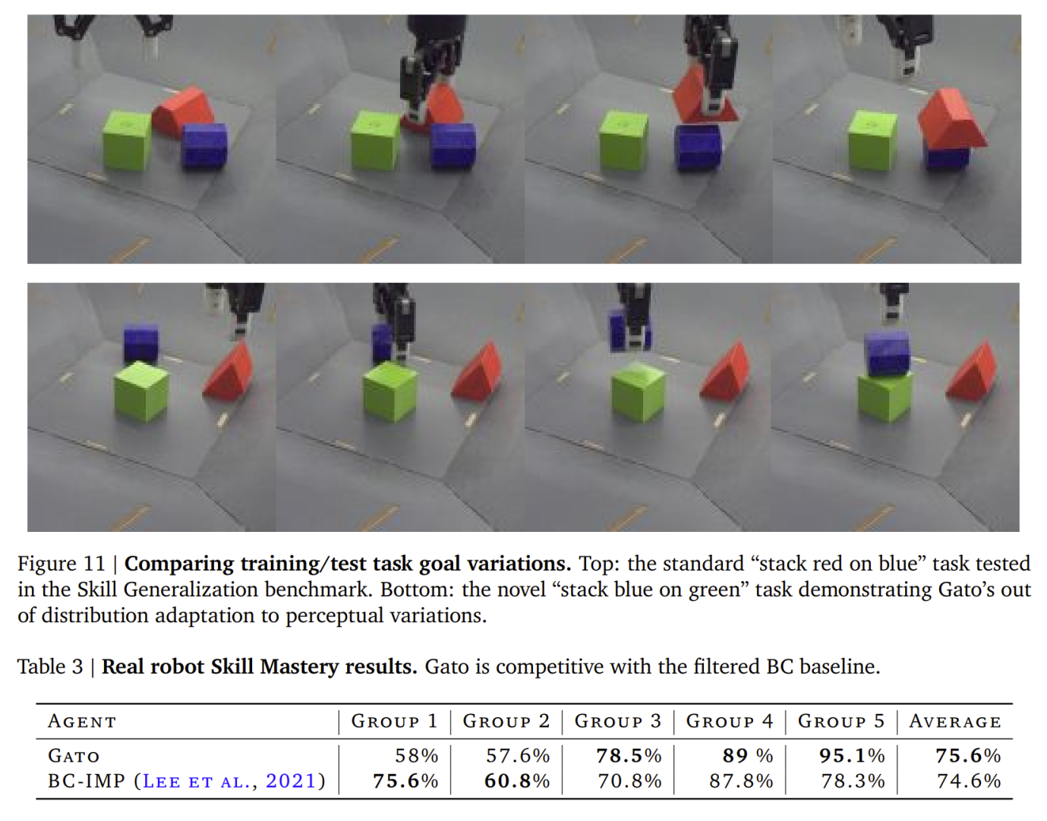

Slide 16

Comment
Far from AGI (Artificial General Intelligence).
Supervised learning but not reinforcement learning.
Show the strength of transformer architecture.

